Slide 2
Inventive Programming by TRIZ
Aleksandr Kugushev

Slide 3

About Me
Contacts
LinkedIn: https://www.linkedin.com/in/kugushev/
GitHub: https://github.com/kugushev
Podcast: https://anchor.fm/dotnetmore
Aleksandr Kugushev
EPAM SYSTEMS,
LEAD SOFTWARE ENGINEER

Slide 4
Disclaimer
Not an introduction to TRIZ
Not required to know TRIZ
Pragmatic approach
Notes:
1. You will find resources at the end of the presentation
2. It’s not necessary to know the theory of category to get benefits from monads
3. Difficult problems require an inventive solution, and TRIZ provides a range of strategies and tools for finding these inventive solutions. We’ll focus just on a few techniques that are extremely helpful for programmers,

Slide 5


Software Development
Expectation
Reality
Stack Overflow
Solving inventive problems

Slide 6

What is an inventive problem?
Notes:
It is like solving puzzle

Slide 7
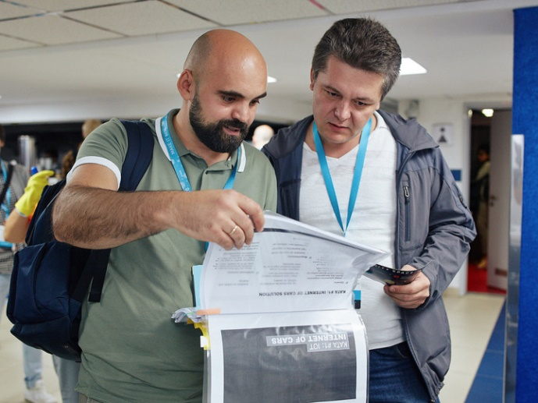

How to solve an inventive problem?
Read a manual
Get a Tip
Ready-Made Solutions
Reference Architecture
TRIZ
Notes:
1. But usually, we can’t find an appropriate pattern or ready-made solution.
2. You still require thinking, but it gives you a directions to appropriate solution

Slide 8
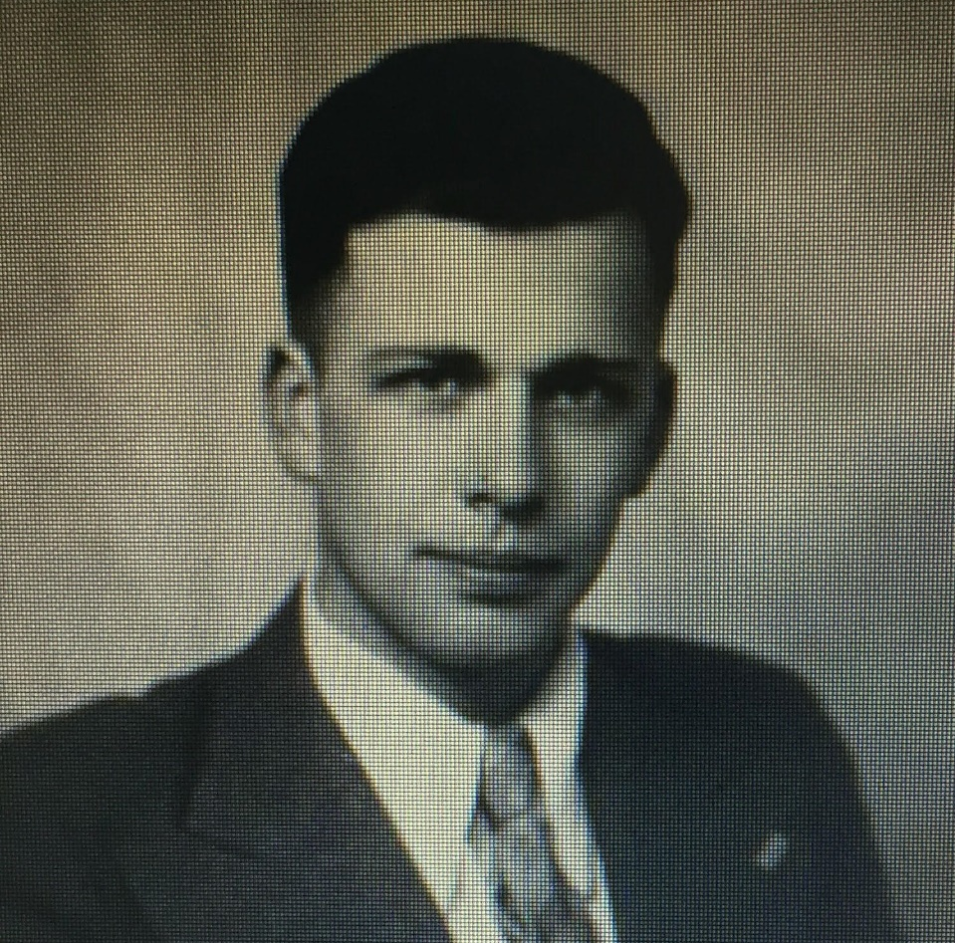
About TRIZ
TRIZ in its classical form was developed by the Soviet inventor Genrich Altshuller and his associates.
By 1969, Altshuller had reviewed about 40,000 patent abstracts in order to find out in what way the innovation had taken place and developed the concept of technical contradictions, the concept of ideality of a system, contradiction matrix, and 40 principles of invention
Notes:
TRIZ is not an insight. Altshuller reviewed plenty of patents and found some correlations between problems and solutions

Slide 9

Basic Principles
V1
V2
V3
Contradiction
Contradiction
Notes:
Chick -> Big Chicken -> Your Dinner
1. No way to create ideal system from scratch
2. We’re developing and reaching the perfect result?
3. What should we do to reach “the next step” to ideal final result?

Slide 10
Contradiction: SSO via SAML
Complexity
Security
Notes:
By reason of valuable functions we can’t get rid of this system.
We need to find out how to deal with harm and keep value.
TRIZ is about solving contradictions

Slide 11

High Level Algorithm
Concrete
Abstract
Concrete Problems
Concrete Solution
SSO via SAML
Abstract Contradictions
TRIZ tools
Invention Ideas
(+) Security / (-) Complexity
Notes:
ARIZ contains 85 steps
Take V1, find contradiction, use tools to solve contradictions

Slide 12
Tools
40 Inventive Principles
Matrix of Contradictions
A suite of tips
Headers: Parameters of a system
Cells: Suitable Inventive Principles
Division
Asymmetry
Merging
Inversion
Another Dimension
…
(+) Security / (-) Complexity
Periodic Action
Self Service
Principle Replacement
Parameter Change
Notes:
We don’t have to review all ideas

Slide 13
Real-world example
Frontend: Search Page
Backend: Search API
Elasticsearch
V5 -> V6
Notes:
Start from the sad story: we decided to update elasticsearch

Slide 14
Contradiction #1: Isolated Tests
Easy to run these tests
Tests doesn’t track changes in Elasticsearch

Slide 15
Contradiction #2: Entities Copy-Paste
Presentation Layer
Application Layer
Domain Layer
Data Access Layer
public class SearchRequestDto { public string Industry { get; set; } public int Headquarters { get; set; } public string Geography { get; set; } public decimal Revenue { get; set; } public decimal Income { get; set; } public decimal EBTDA { get; set; } public string Owner { get; set; } public string Partner { get; set; } public decimal IRR { get; set; } ... }
public class SearchRequestUseCase { public string Industry { get; set; } public int Headquarters { get; set; } public string Geography { get; set; } public decimal Revenue { get; set; } public decimal Income { get; set; } public decimal EBTDA { get; set; } public string Owner { get; set; } public string Partner { get; set; } public decimal IRR { get; set; } ... }
public class SearchRequestEntity { public string Industry { get; set; } public int Headquarters { get; set; } public string Geography { get; set; } public decimal Revenue { get; set; } public decimal Income { get; set; } public decimal EBTDA { get; set; } public string Owner { get; set; } public string Partner { get; set; } public decimal IRR { get; set; } ... }
public class SearchRequestDao { public string Industry { get; set; } public int Headquarters { get; set; } public string Geography { get; set; } public decimal Revenue { get; set; } public decimal Income { get; set; } public decimal EBTDA { get; set; } public string Owner { get; set; } public string Partner { get; set; } public decimal IRR { get; set; } ... }

Slide 16
Contradiction #2: Entities Copy-Paste
Easy to deal with API changes
Have to write mappings and duplicate changes

Slide 17
Contradictions: High Level
Isolated Tests
Entities Copy-Paste
System Convenience
External Risks
Adaptability
System Complexity
Notes:
Isolated Tests
(+) Easy to run these tests: System Convenience
(-) Tests doesn’t track changes in Elasticsearch: External Risks
Entities Copy-Paste
(+) Easy to deal with API changes: Adaptability
(-) Have to write mappings and duplicate changes: System Complexity

Slide 18
DEMO

Slide 19




Contradiction #1: Isolated Tests
#02 TAKING AWAY
#04 ASYMMETRY
#19 PERIODIC ACTION
#37 RELATIVE CHANGE

Slide 20
Contradiction #1: Isolated Tests
Unit Tests:
Given Limit 5 When Search Then 5 Rows
Given “Rev” When Search Then “Revenue”
Given Currency $ When Search Then 10$
#02 TAKING AWAY
Take away some tests to integration tests suite

Slide 21
Contradiction #1: Isolated Tests
Unit Tests:
Given Limit 5 When Search Then 5 Rows
Given “Rev” When Search Then “Revenue”
Given Currency $ When Search Then 10$
Integration Tests:
Given “Rev” When Search Then “Revenue”
Given Currency $ When Search Then 10$
#02 TAKING AWAY
Take away some tests to integration tests suite

Slide 22
Contradiction #1: Isolated Tests
Integration Tests
Unit Tests
??? Tests
200+ Tests
100% Branch Coverage
??? Coverage
#04 ASYMMETRY
Follow the test pyramid principle

Slide 23
Contradiction #1: Isolated Tests
Integration Tests
Unit Tests
20+ Tests
200+ Tests
100% Branch Coverage
100% Bugs and Corner cases Coverage
#04 ASYMMETRY
Follow the test pyramid principle

Slide 24
Contradiction #1: Isolated Tests
Elasticsearch
Build On Commit
Build On Commit
Build On Commit
#19 PERIODIC ACTION
Run these tests on the night rather than after each commit

Slide 25
Contradiction #1: Isolated Tests
Day
Unit Tests
Unit Tests
Night
Integration Tests
Integration Tests
Integration Tests
Unit Tests
#19 PERIODIC ACTION
Run these tests on the night rather than after each commit

Slide 26

Contradiction #1: Isolated Tests
Integration Tests
#37 RELATIVE CHANGE
Application
Use integration tests of another service to seed DB
Elasticsearch

Slide 27
Contradiction #1: Isolated Tests
Integration Tests
Integration Tests
#37 RELATIVE CHANGE
Another Application
Application
Use integration tests of another service to seed DB
Elasticsearch

Slide 28


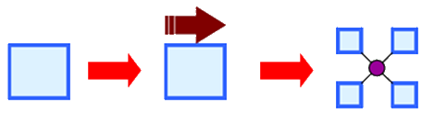

Contradiction #2: Entities Copy-Paste
#05 MERGING
#14 NON-LINEARITY
#15 DYNAMIZATION
#25 SELF-SERVICE

Slide 29
Contradiction #2: Entities Copy-Paste
Domain
Application
Presentation
SearchRequestEntity
DAL
SearchRequestUseCase
SearchRequestDao
SearchRequestDto
#05 MERGING
Merge all representation of an entity to the one

Slide 30
Contradiction #2: Entities Copy-Paste
Domain
Application
DAL
Presentation
#05 MERGING
Merge all representation of an entity to the one
public class SearchRequest

Slide 31
Contradiction #2: Entities Copy-Paste
public class SearchRequest { public SearchRequest(SearchRequestDto dto) { Industry = dto.Industry; Headquarters = dto.Headquarters; Geography = dto.Geography; Revenue = dto.Revenue; Income = dto.Income; EBTDA = dto.EBTDA; Owner = dto.Owner; InvestmentId = dto.InvestmentId; Partner = dto.Partner; IRR = dto.IRR; } public string Industry { get; } public int Headquarters { get; } public string Geography { get; } public decimal Revenue { get; } public decimal Income { get; } public decimal EBTDA { get; } public string Owner { get; } public int InvestmentId { get; } public string Partner { get; } public decimal IRR { get; } }
public class SearchRequest { public SearchRequest(string industry, int headquarters, string geography,
decimal revenue, decimal income, decimal ebtda, string owner, int investmentId,
string partner, decimal irr) { Industry = industry; Headquarters = headquarters; Geography = geography; Revenue = revenue; Income = income; EBTDA = ebtda; Owner = owner; InvestmentId = investmentId; Partner = partner; IRR = irr; } public string Industry { get; } public int Headquarters { get; } public string Geography { get; } public decimal Revenue { get; } public decimal Income { get; } public decimal EBTDA { get; } public string Owner { get; } public int InvestmentId { get; } public string Partner { get; } public decimal IRR { get; } }
Notes:
No way to deserialize json to this entitiy

Slide 32
Contradiction #2: Entities Copy-Paste
public class SearchRequest { public SearchRequest(SearchRequestDto dto) { Industry = dto.Industry; Headquarters = dto.Headquarters; Geography = dto.Geography; Revenue = dto.Revenue; Income = dto.Income; EBTDA = dto.EBTDA; Owner = dto.Owner; InvestmentId = dto.InvestmentId; Partner = dto.Partner; IRR = dto.IRR; } public string Industry { get; } public int Headquarters { get; } public string Geography { get; } public decimal Revenue { get; } public decimal Income { get; } public decimal EBTDA { get; } public string Owner { get; } public int InvestmentId { get; } public string Partner { get; } public decimal IRR { get; } }
#14 NON-LINEARITY
High level entity should be interface than class
Notes:
Stop thinking about properties assignment

Slide 33
Contradiction #2: Entities Copy-Paste
public interface ISearchRequest { public string Industry { get; } public int Headquarters { get; } public string Geography { get; } public decimal Revenue { get; } public decimal Income { get; } public decimal EBTDA { get; } public string Owner { get; } public int InvestmentId { get; } public string Partner { get; } public decimal IRR { get; } }
#14 NON-LINEARITY
High level entity should be interface than class
Notes:
Stop thinking about properties assignment

Slide 34
Contradiction #2: Entities Copy-Paste
public interface ISearchRequest { public string Industry { get; } public int Headquarters { get; } public string Geography { get; } public decimal Revenue { get; } public decimal Income { get; } public decimal EBTDA { get; } public string Owner { get; } public int InvestmentId { get; } public string Partner { get; } public decimal IRR { get; } }
public class SearchRequestDto : ISearchRequest { public string Industry { get; set; } public int Headquarters { get; set; } public string Geography { get; set; } public decimal Revenue { get; set; } public decimal Income { get; set; } public decimal EBTDA { get; set; } public string Owner { get; set; } public int InvestmentId { get; set; } public string Partner { get; set; } public decimal IRR { get; set; } }
Notes:
Instead of mapping we use interface implementation

Slide 35
Contradiction #2: Entities Copy-Paste
public class SearchFinanceRequest { public decimal Revenue { get; set; } public decimal Income { get; set; } public decimal EBTDA { get; set; } } public class SearchInvestmentRequest { public int InvestmentId { get; set; } public string Partner { get; set; } public decimal IRR { get; set; } }
public class SearchRequestDto : ISearchRequest { public string Industry { get; set; } public int Headquarters { get; set; } public string Geography { get; set; } public decimal Revenue { get; set; } public decimal Income { get; set; } public decimal EBTDA { get; set; } public string Owner { get; set; } public int InvestmentId { get; set; } public string Partner { get; set; } public decimal IRR { get; set; } }

Slide 36
Contradiction #2: Entities Copy-Paste
public class SearchFinanceRequest { public decimal Revenue { get; set; } public decimal Income { get; set; } public decimal EBTDA { get; set; } } public class SearchInvestmentRequest { public int InvestmentId { get; set; } public string Partner { get; set; } public decimal IRR { get; set; } }
interface ISearchBuilder { void SearchFinance(SearchFinanceRequest r); void SearchInvestment(SearchInvestmentRequest r); }
void Search(ISearchBuilder searchBuilder,
IMapper mapper, SearchRequestDto request) { searchBuilder.SearchFinance(
mapper.Map<SearchFinanceRequest>(request)); searchBuilder.SearchInvestment(
mapper.Map<SearchInvestmentRequest>(request)); }
Notes:
But we are trying to keep one class

Slide 37
Contradiction #2: Entities Copy-Paste
public class SearchFinanceRequest { public decimal Revenue { get; set; } public decimal Income { get; set; } public decimal EBTDA { get; set; } } public class SearchInvestmentRequest { public int InvestmentId { get; set; } public string Partner { get; set; } public decimal IRR { get; set; } }
#15 DYNAMIZATION
Specify in a parameter type a required interface
Notes:
Making something automatic

Slide 38
Contradiction #2: Entities Copy-Paste
public interface ISearchFinanceRequest { public decimal Revenue { get; set; } public decimal Income { get; set; } public decimal EBTDA { get; set; } } public interface ISearchInvestmentRequest { public int InvestmentId { get; set; } public string Partner { get; set; } public decimal IRR { get; set; } }
#15 DYNAMIZATION
Specify in a parameter type a required interface
Notes:
Making something automatic. Avoid extra work

Slide 39
Contradiction #2: Entities Copy-Paste
public class SearchRequestDto : ISearchRequest, ISearchFinanceRequest, ISearchInvestmentRequest { public string Industry { get; set; } public int Headquarters { get; set; } public string Geography { get; set; } public decimal Revenue { get; set; } public decimal Income { get; set; } public decimal EBTDA { get; set; } public string Owner { get; set; } public int InvestmentId { get; set; } public string Partner { get; set; } public decimal IRR { get; set; } }
public interface ISearchFinanceRequest { public decimal Revenue { get; set; } public decimal Income { get; set; } public decimal EBTDA { get; set; } } public interface ISearchInvestmentRequest { public int InvestmentId { get; set; } public string Partner { get; set; } public decimal IRR { get; set; } }

Slide 40
Contradiction #2: Entities Copy-Paste
interface ISearchBuilder { void SearchFinance(ISearchFinanceRequest r); void SearchInvestment(ISearchInvestmentRequest r); }
public class SearchRequestDto : ISearchRequest, ISearchFinanceRequest, ISearchInvestmentRequest { public string Industry { get; set; } public int Headquarters { get; set; } public string Geography { get; set; } public decimal Revenue { get; set; } public decimal Income { get; set; } public decimal EBTDA { get; set; } public string Owner { get; set; } public int InvestmentId { get; set; } public string Partner { get; set; } public decimal IRR { get; set; } }
void Search(ISearchBuilder searchBuilder, SearchRequestDto request) { searchBuilder.SearchFinance(request); searchBuilder.SearchInvestment(request); }
Notes:
We’re avoiding extra mappings

Slide 41
Contradiction #2: Entities Copy-Paste
class SearchRefinementsDto { public List<RefinementDto> Refinements { get; set; } } class RefinementDto { public string Name { get; set; } public int Amount { get; set; } }
interface ISearchRefinements { IReadOnlyList<IRefinement> Refinements { get; } } interface IRefinement { string Name { get; } int Amount { get; } }
Notes:
How to deal with mismatches between dto and our entity representation?

Slide 42
Contradiction #2: Entities Copy-Paste
class SearchRefinementsDto:
ISearchRefinements { public List<RefinementDto> Refinements { get; set; } } class RefinementDto: IRefinement { public string Name { get; set; } public int Amount { get; set; } }
interface ISearchRefinements { IReadOnlyList<IRefinement> Refinements { get; } } interface IRefinement { string Name { get; } int Amount { get; } }
Property 'Refinements' cannot implement
property from interface 'ISearchRefinements'
Notes:
How to deal with details in Dto that shouldn’t be revealed in Entity?

Slide 43
Contradiction #2: Entities Copy-Paste
class SearchRefinementsDto:
ISearchRefinements { public List<RefinementDto> Refinements { get; set; } } class RefinementDto: IRefinement { public string Name { get; set; } public int Amount { get; set; } }
#25 SELF-SERVICE
Property 'Refinements' cannot implement
property from interface 'ISearchRefinements'
Classes that implement interface solves mismatches on its own
Notes:
How to deal with details in Dto that shouldn’t be revealed in Entity?

Slide 44
Contradiction #2: Entities Copy-Paste
class SearchRefinementsDto: ISearchRefinements { public List<RefinementDto> Refinements { get; set; } IReadOnlyList<IRefinement> ISearchRefinements.Refinements => Refinements; }
Notes:
How to deal with details in Dto that shouldn’t be revealed in Entity?

Slide 45
How to find contradictions?

Slide 46


Root Conflict Analysis
Found bugs on production after Elasticsearch update
Easy to run these tests
Tests doesn’t track changes in Elasticsearch
All tests are independent from Elasticsearch
Notes:
Can we get rid of tests?

Slide 47
Root Conflict Analysis Algorithm
Identify the problem
Answer: why it happens?
Does this thing provide value to the system?
Yes: We found a contradiction!
No: GOTO #2

Slide 48
Conclusion
Notes:
Inventive Programming is not a rocket science, but if you face issues with rocket science complexity, you can use TRIZ tools to simplify it

Slide 49
Materials
Altshuller, Genrich: Any Book
http://www.xtriz.com/
https://github.com/kugushev/triz4programmers
https://triz-journal.com/
TRIZ And Software Innovation: Historical Perspective And An Application Case Study Darrell Mann https://www.aitriz.org/articles/TRIZFeatures/323031312D30382D4D616E6E.pdf

